Slide 1


Difference-in-Differences and Instrumental Variable
Ekonometrika untuk Penelitian
Muhammad Akmal Farouqi
27/3/2024
www.ugm.ac.id
Locally Rooted, Globally Respected

Slide 2
Difference-in-differences

Slide 3
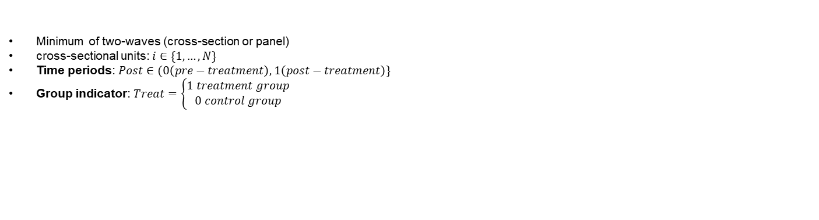
Why DiD?
The main challenge in microeconometrics is to obtain a valid counterfactual, in order to estimates the causal relationship of a particular intervention. Relying only on national surveys or observational data might be difficult because treated and compared groups usually have different characteristics. Therefore, observing pre-treatment outcome is important!
Data structure
Minimum of two-waves (cross-section or panel)
cross-sectional units: $i∈\{1,…,N\}$
Time periods: $Post∈(0\left(pre−treatment\right),1\left(post−treatment\right)\}$
Group indicator: $Treat=\left\{\begin{aligned}1 treatment group \\ 0 control group\end{aligned}\right.$
The DiD model interacts the two variables
(with & without) What if we regress $y=β_{0}+β_{1}\left(treated\right)+ε$?
possible bias due to different characteristics that may contribute on the over/underestimates of the intervention
(before & after) What if we regress $y=β_{0}+β_{1}\left(post−treatment\right)+ε?$
Possible bias because the time-varying changes of the outcome doesn’t only associated with the intervention.
The idea is to compare the differences in group and differences in time

Slide 4
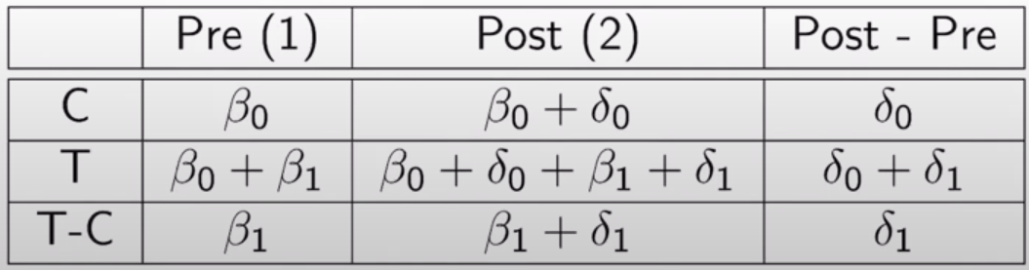
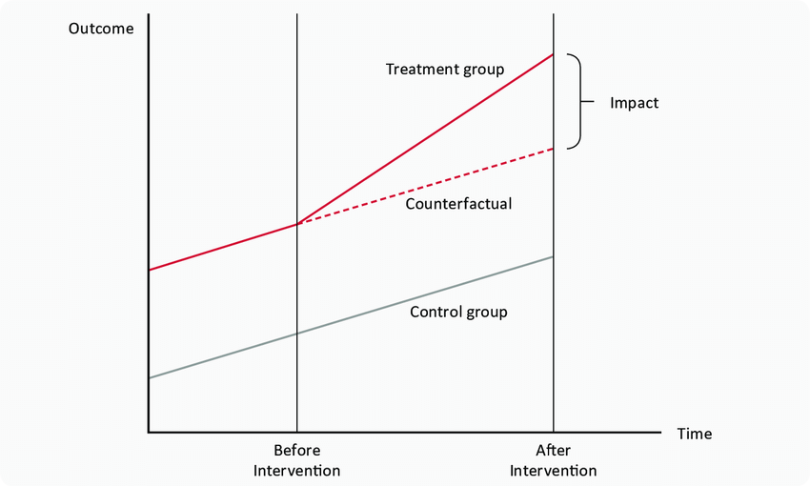
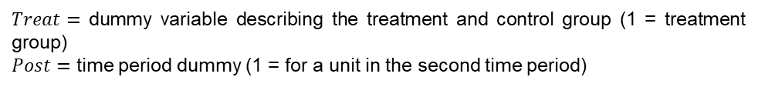
Equation and Intuition
$$y_{it}=β_{0}+β_{1}Treat_{i}+δ_{0}Post_{t}+δ_{1}Treat_{s}×Post_{t}+u_{it}$$
$Treat=$ dummy variable describing the treatment and control group (1 = treatment group)
$Post=$ time period dummy (1 = for a unit in the second time period)
Transformation result
Main DiD parameter that has been isolated from different characteristics and time-varying biases
with & without’s source of bias
before & after’s source of bias
Control group acted as the “trend” of the treated, which was then used as the comparison (or counterfactual)
This framework mimics controlled experiments that happened naturally to one group of people but not to another: quasi-experiments

Slide 5
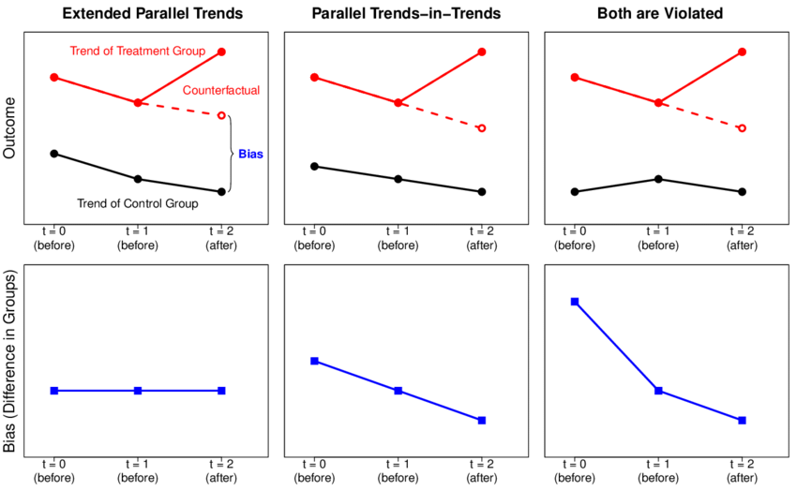
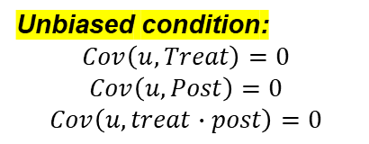
Some things to note
Parellel trend assumption:
A potential problem arises when control and treatment groups have different trending rates. As a result, the estimated effect is no longer accurate, because the counterfactual assumption is not valid.
To solve this problem, we either get another control group or more years of data
Unbiased condition:
$$Cov\left(u,Treat\right)=0$$
$$Cov\left(u,Post\right)=0$$
$$Cov\left(u,treat∙post\right)=0$$
This is known as parallel-trend assumption
Correlated standard errors:
In many research, DiD uses many years of data, arising issues:
Outcomes are correlated across years
Error terms or unobservable are correlated across years

Slide 6
Instrumental Variables

Slide 7
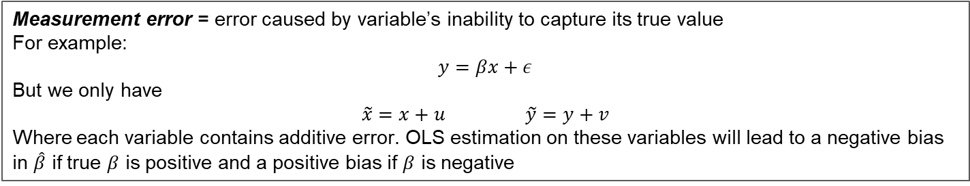
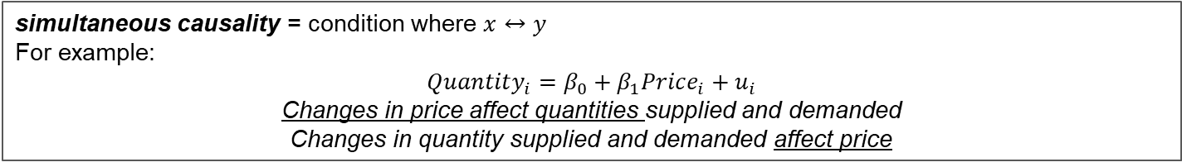
Instrumental Variables (IV) are useful for estimating models with:
Measurement error = error caused by variable’s inability to capture its true value
For example:
$$y=βx+ε$$
But we only have
$$\tilde{x}=x+u \tilde{y}=y+v$$
Where each variable contains additive error. OLS estimation on these variables will lead to a negative bias in $\hat{β}$ if true $β$ is positive and a positive bias if $β$ is negative
simultaneous causality = condition where $x↔y$
For example:
$$Quantity_{i}=β_{0}+β_{1}Price_{i}+u_{i}$$
Changes in price affect quantities supplied and demanded
Changes in quantity supplied and demanded affect price
omitted variable bias= arises when:
$X$ is correlated with the omitted variable
The omitted variable is a determinant of the dependent variable $Y$

Slide 8
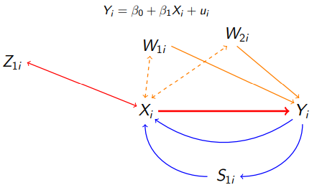
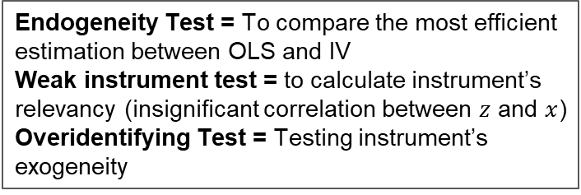
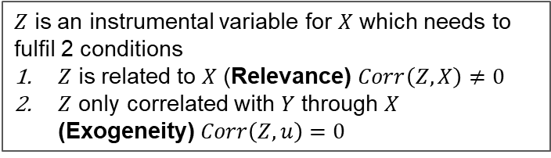
Instrumental Variable
In conclusion, we use IV when model fails conditional mean independence assumption $E\left(u | X,W\right)=E(u|W)$
exclusion restrictions
Intuition
$Z$ is an instrumental variable for $X$ which needs to fulfil 2 conditions
$Z$ is related to $X$ (Relevance) $Corr\left(Z,X\right)≠0$
$Z$ only correlated with $Y$ through $X$ (Exogeneity) $Corr\left(Z,u\right)=0$
OVB
Diagnostic Tests
Endogeneity Test = To compare the most efficient estimation between OLS and IV
Weak instrument test = to calculate instrument’s relevancy (insignificant correlation between $z$ and $x$)
Overidentifying Test = Testing instrument’s exogeneity
Simultaneous Causality

Slide 9






2SLS estimation for Instrumental Variable
Two-Stage Least Squares (2SLS) is a method used to estimate causal relationships when there is endogeneity between the independent variable and the error term. It works by first using an instrumental variable (which is correlated with the endogenous variable but not with the error term) to predict the problematic regressor and then using this predicted value in a second regression to estimate the causal effect.
Let’s begin with an equation
$y=β_{0}+β_{1}x_{1}+β_{2}w_{1}+ε,$ where $x_{1}$ is an endogenous variable (correlated with $ε$)
We need $z$, an instrument that satisfies relevance and exogeneity
Then, we can estimate the first stage below:
First stage
Second stage
$$x_{1}=π_{0}+π_{1}z+γ_{1}w_{1}+v_{1}$$
Insert ${\hat{x}}_{1}$ to the main equation and estimate the equation!
And we get the estimated value of $x_{1}$ or ${\hat{x}}_{1}$
$$y=β_{0}+β_{1}{\hat{x}}_{1}+β_{2}w_{1}+ε$$
$${\hat{x}}_{1}={\hat{π}}_{0}+{\hat{π}}_{1}z+{\hat{γ}}_{1}w_{1}$$

Slide 10
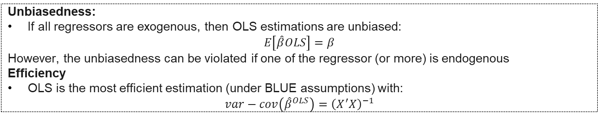
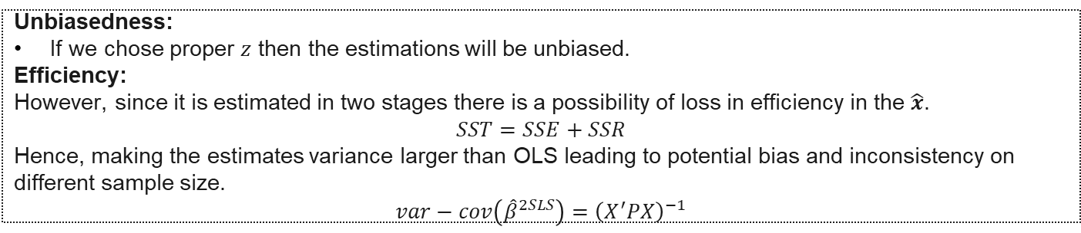
Unbiasedness vs Efficiency
OLS (Ordinary Least Squares)
Unbiasedness:
If all regressors are exogenous, then OLS estimations are unbiased:
$$E\left[\hat{β}OLS\right]=β$$
However, the unbiasedness can be violated if one of the regressor (or more) is endogenous
Efficiency
OLS is the most efficient estimation (under BLUE assumptions) with:
$$var−cov\left({\hat{β}}^{OLS}\right)={\left(X^{′}X\right)}^{−1}$$
IV 2SLS
Unbiasedness:
If we chose proper $z$ then the estimations will be unbiased.
Efficiency:
However, since it is estimated in two stages there is a possibility of loss in efficiency in the $\hat{x}$.
$$SST=SSE+SSR$$
Hence, making the estimates variance larger than OLS leading to potential bias and inconsistency on different sample size.
$$var−cov\left({\hat{β}}^{2SLS}\right)={\left(X^{′}PX\right)}^{−1}$$

Slide 11
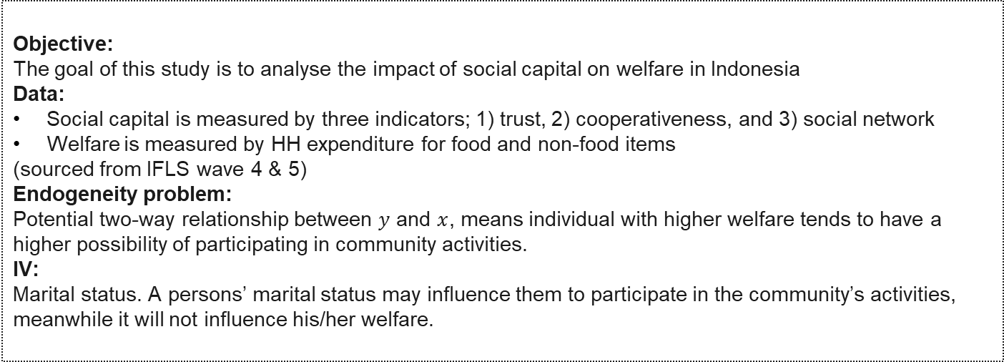
Example (Jumirah & Wahyuni, 2018)
THE EFFECT OF SOCIAL CAPITAL ON WELFARE IN INDONESIA
Objective:
The goal of this study is to analyse the impact of social capital on welfare in Indonesia
Data:
Social capital is measured by three indicators; 1) trust, 2) cooperativeness, and 3) social network
Welfare is measured by HH expenditure for food and non-food items
(sourced from IFLS wave 4 & 5)
Endogeneity problem:
Potential two-way relationship between $y$ and $x$, means individual with higher welfare tends to have a higher possibility of participating in community activities.
IV:
Marital status. A persons’ marital status may influence them to participate in the community’s activities, meanwhile it will not influence his/her welfare.
Notes:
https://core.ac.uk/reader/297708750

Slide 12
Another Example
Source | Z | X | Y
Mulyaningsih et al., 2021 | Distance to school | Years of education | earnings
Alfada, 2019 | Corruption conviction rate | Corruption case | Economic growth
Priebe, 2010 | Same-sex siblings’ parent | Fertility rate | Labor Market

Slide 13
Thank You

